Slide 1
Identify Millennials Interested in High-End Dance Bands through Transactional Data
Team members:
Suqiang Song & Claudia Remley

Slide 2
Business Problem
The client is an entertainment company offering customized and proprietary experiences. One of their specialized offerings is high-end dance bands for special occasions, particularly weddings.
The business problem is that the client has little recurring revenue so they are always in need of identifying new customers to sustain their revenue.
We will use a high-end entertainment company as the example here and use credit card transaction data from a mid-level bank in the US to segment consumers and create consumer profiles (labels).
The consumer profiles will be used to identify and target consumers with specialized offers in an effort to increase sales and make the marketing dollars more productive.

Slide 3
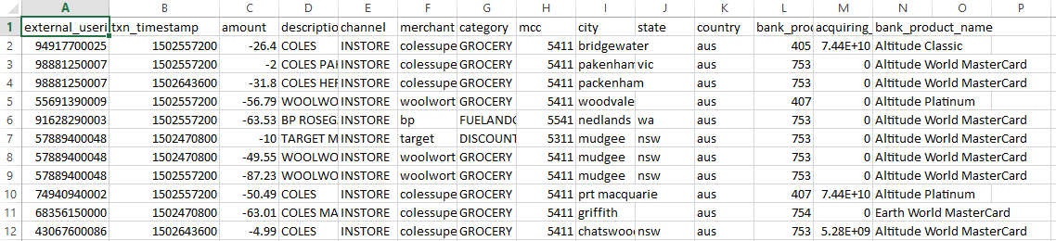
Data Source
Real MasterCard credit card transactions from a mid-bank in the U.S.
Note: considering the information security and data privacy policies from MasterCard, we are not going to expose any real raw transaction data out of the MasterCard network. In our proposal, we will start from the features data after aggregation and other data formatting, and only touch a small group of users (10 k total), we also will remove all the PCI/PII information.

Slide 4
Preliminary Work
Data
Data collection and feature engineering (pre-calculate 126 Long Term Variables for each user, such as total spends /visits for merchants list, category list from last 6 months)
The raw data is huge and hard for R to do some of work needed. As a result we will use Python and Hadoop initially and then download to R Studio
Business
Discussions with client and review of internal SalesForce data to gather information and hone suggestions for consumer targeting

Slide 5
Planned Analyses
Consumer segmentation ( K-means clustering )
Exploring the credit card data and finding merchants or categories that show discriminating behavior particularly around high-end jewelry and entertainment brands.
Review segmented data to identify potential opportunities for marketing programs through feature generation and consumer segmentation.

Slide 6
Risk Assessment
Our primary risks include:
The challenges around how to identify the relevant merchants and categories associated with Millennials that can help the merchant/client
Evaluating the quality of the model and the consumer segmentations
Pulling too much data making this project difficult to complete in the allotted time.

Slide 7
Data Understanding
Based on relevant client information, SS analyzed MasterCard data, related information and converted this information into relevant offer campaign conditions and did pre-selection of target user group that is the first-round segmentation.
Considering data requirements SS Identified the targeting offer campaign conditions from marketing data sets, relevant merchants and category, created training and validation data sets and generated the features data sets from huge raw data and selected small users amount for easy analysis.
Initial data collection, exploration, and quality assessment included the collection of raw transactions data from Mastercard internal data sources, such as Hadoop Data Lake.
Data was downloaded into GitHub and brought into R-Studio for review and analysis by CR. Adjustments are being made to final tags to refine target selections for final data analysis.
CR received complete file of SalesForce Data from client. Reviewed SalesForce data to understand what would be most meaningful to inform project.

Slide 8
REGARDING DEMOGRAPHICS AND OTHER MARKETING INFORMATION
The target is someone who is getting married.
People pay to have these bands fly all over the country to perform at a wedding, so there is a level of sophistication involved and an appreciation for music.
They (or their parents) have enough discretionary money and sophistication to be interested in spending $15,000-$25,000 on a musical group (dance band) for their wedding reception when they get married.
The millennial age group is a good target population because they are getting married in more lavish weddings.
Any tags that allow for there to be a focus on identifying who could potentially be unmarried would be good (I realize the privacy issues), or people who have an appreciation for finer things or are music lovers would also be good targets.
The majority of my clients current leads come from extended affluent urban centers (NY, DC, Chicago, LA, San Francisco, Miami, Palm Beach, Philadelphia, Boston, Denver), but extending out to other affluent urban centers would also make sense so that they could grow their business—such as Atlanta, Charleston SC, Texas cities, would also be good.
Anecdotally, the band selection is one of the few decisions that the majority of the grooms are involved in when getting married—and often times are leading the decision.
There is also an anecdotal belief that the majority of marriage engagements happen over the holidays between 11/1 and Valentine’s day 2/14.
Other anecdotal information is that once engaged the contracting of the band is one of the first actions taken in preparation for the wedding. As a result my client sees an uptick in leads during Q4 and Q1, although it does not show through in the contracting of business.

Slide 9
Data Preparation (Pre-Selection)
For raw data, we chose Mastercard transactions from a mid-level bank in the US from 02/01/2016 to 02/01/2017, we also prepared the test / validate data sets to evaluate the model quality, the time range is from 02/02/2017 to 02/01/2018 ,including 119,335 users, 11,595,319 transactions and 2,727 merchants, 113 Categories.
For the SF data, CR reviewed the different data files that were provided, identified several with relevant data information. The data files were cleaned—filling in missing pieces, adding fields as well as removing unnecessary data fields. Relevant data was selected to conduct initial analysis and to bring into R-Studio for further review and analysis.
For pre-selection , we considered the “DEMOGRAPHICS” requirements and choose 5 marketing tags for pre-filtering ,including:
HomeOwner(0),MortgageLast12months(0),Frequent MusicBuyer(1),Frequent JewelerBuyer(1),HeavyTotalSpendLast6months(500$ per month)(1)
After the pre-selection , there are 27906 users selected and we can do the furthermore clustering now.

Slide 10
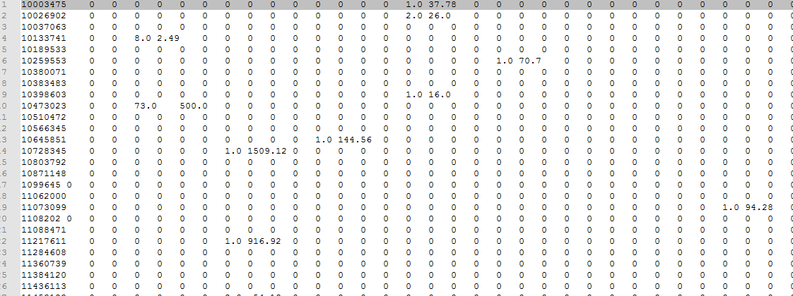
Data Preparation (Feature Generation)
For Mastercard data, data collected from internal data source, input data format is text file in HDFS. Data was cleaned and unqualified data sets were removed. The data was transformed and enriched by SS who ran a Hadoop streaming map-reduce job to generate features data sets from raw data, ready for R application
Visits and Average spend per visit to Millennial merchants used as features in one model, 137 columns
Some examples of columns : "google_visit","apple_visit","jcrew_visit","itunes_visit","google_aveSpend","apple_aveSpend","jcrew_aveSpend","itunes_aveSpend"
Notes:
[1] "User" "limited_visit" [3] "limited_aveSpend" "google_visit" [5] "google_aveSpend" "roxy_visit" [7] "roxy_aveSpend" "apple_visit" [9] "apple_aveSpend" "tillys_visit" [11] "tillys_aveSpend" "jcrew_visit" [13] "jcrew_aveSpend" "sweetwater_visit" [15] "sweetwater_aveSpend" "groupon_visit" [17] "groupon_aveSpend" "americanapparel_visit" [19] "americanapparel_aveSpend" "ralphlauren_visit" [21] "ralphlauren_aveSpend" "lanebryant_visit" [23] "lanebryant_aveSpend" "guitarcenter_visit" [25] "guitarcenter_aveSpend" "hottopic_visit" [27] "hottopic_aveSpend" "quiksilver_visit" [29] "quiksilver_aveSpend" "zappos_visit" [31] "zappos_aveSpend" "urbanoutfitters_visit" [33] "urbanoutfitters_aveSpend" "modcloth_visit" [35] "modcloth_aveSpend" "abercrombiefitch_visit" [37] "abercrombiefitch_aveSpend" "jrmusicworld_visit" [39] "jrmusicworld_aveSpend" "roots_visit" [41] "roots_aveSpend" "tomsshoes_visit" [43] "tomsshoes_aveSpend" "guess_visit" [45] "guess_aveSpend" "finishline_visit" [47] "finishline_aveSpend" "justmemusic_visit" [49] "justmemusic_aveSpend" "activecom_visit" [51] "activecom_aveSpend" "luckybrandjeans_visit" [53] "luckybrandjeans_aveSpend" "zumiez_visit" [55] "zumiez_aveSpend" "diesel_visit" [57] "diesel_aveSpend" "kennethcole_visit" [59] "kennethcole_aveSpend" "katespade_visit" [61] "katespade_aveSpend" "bananarepublic_visit" [63] "bananarepublic_aveSpend" "theplanet_visit" [65] "theplanet_aveSpend" "fossil_visit" [67] "fossil_aveSpend" "brooksbrothers_visit" [69] "brooksbrothers_aveSpend" "musiciansfriend_visit" [71] "musiciansfriend_aveSpend" "vans_visit" [73] "vans_aveSpend" "rue21_visit" [75] "rue21_aveSpend" "bmi_visit" [77] "bmi_aveSpend" "landsend_visit" [79] "landsend_aveSpend" "gap_visit" [81] "gap_aveSpend" "hulu_visit" [83] "hulu_aveSpend" "juicycouture_visit" [85] "juicycouture_aveSpend" "amazon_visit" [87] "amazon_aveSpend" "truereligion_visit" [89] "truereligion_aveSpend" "americanmusicalsupply_visit" [91] "americanmusicalsupply_aveSpend" "reef_visit" [93] "reef_aveSpend" "hm_visit" [95] "hm_aveSpend" "izod_visit" [97] "izod_aveSpend" "diamondsinternational_visit" [99] "diamondsinternational_aveSpend" "lids_visit" [101] "lids_aveSpend" "lululemon_visit" [103] "lululemon_aveSpend" "thenorthface_visit" [105] "thenorthface_aveSpend" "americaneagle_visit" [107] "americaneagle_aveSpend" "bcbg_visit" [109] "bcbg_aveSpend" "williamssonoma_visit" [111] "williamssonoma_aveSpend" "netflix_visit" [113] "netflix_aveSpend" "reebok_visit" [115] "reebok_aveSpend" "oldnavy_visit" [117] "oldnavy_aveSpend" "itunes_visit" [119] "itunes_aveSpend" "jcrewfactory_visit" [121] "jcrewfactory_aveSpend" "whitehouseblackmarket_visit" [123] "whitehouseblackmarket_aveSpend" "levis_visit" [125] "levis_aveSpend" "cartier_visit" [127] "cartier_aveSpend" "loves_visit" [129] "loves_aveSpend" "act_visit" [131] "act_aveSpend" "zara_visit" [133] "zara_aveSpend" "hollister_visit" [135] "hollister_aveSpend" "aeropostale_visit" [137] "aeropostale_aveSpend"

Slide 11
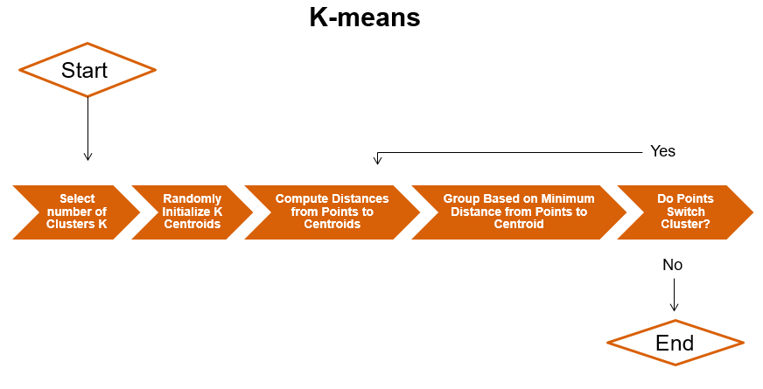
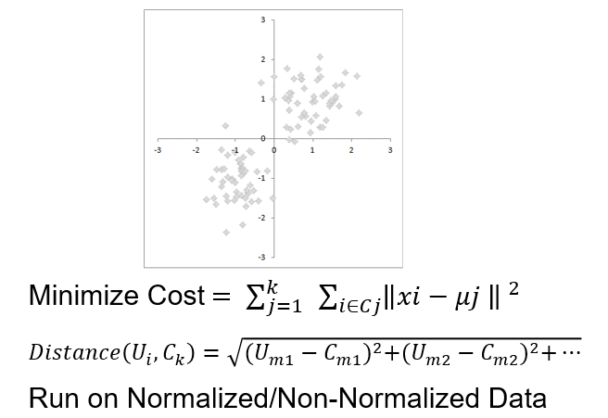
Modeling & Algorithm -- Clustering

Slide 12
Modeling & Algorithm -- Steps
Read in the data, load the features data sets from csv file
Sample/separate data, such as user_visit , user_avgSpend …
define the UDFs which help to find best K and generate Millennial
Clustered on Visits to Millennial Merchants
Clustered on Average Spend per visit to Millennial Merchants
Clustered on Visits + Average Spend per visit to Millennial Merchants
For each clustered step , execute 2 round clustering , first one to narrow down to a smaller scope ,the second one to identify the final Millennial users.
Analyzed for outliers
Repeat

Slide 13
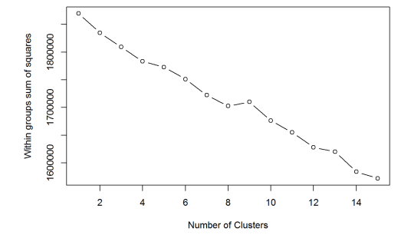
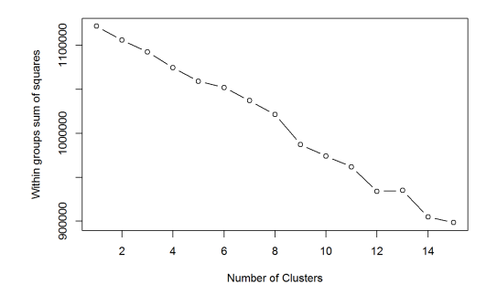
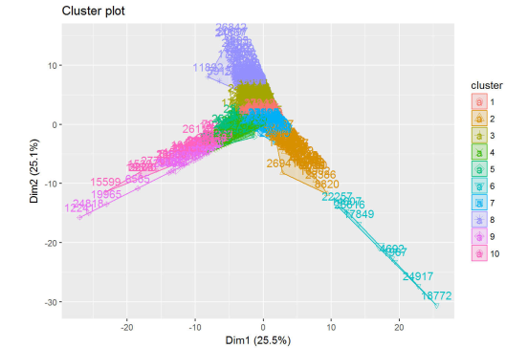
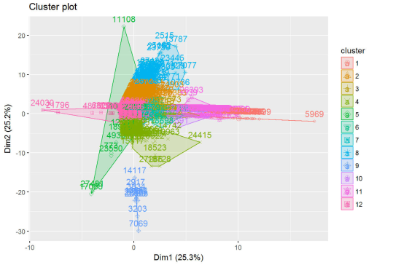
Optimal Number of Clusters:

Slide 14
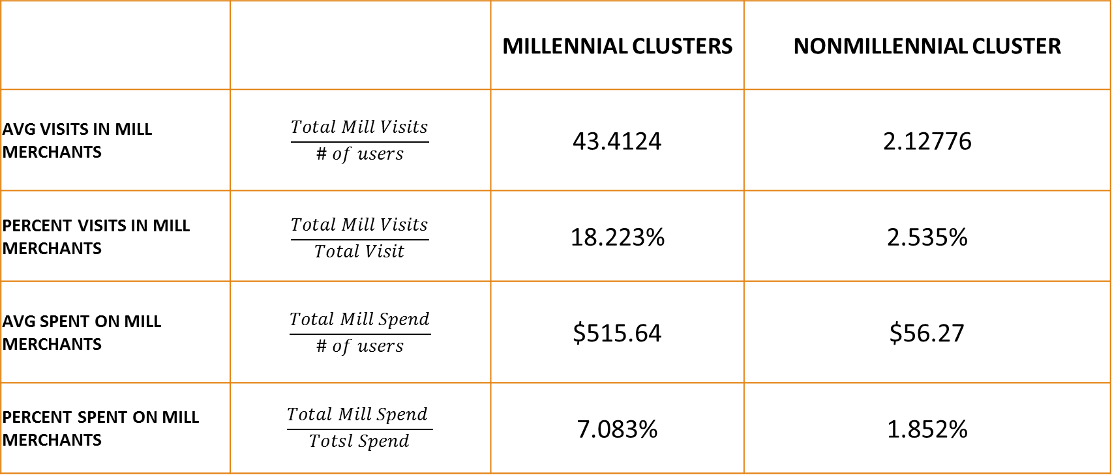
Model evaluation (Clustered on Visits) targeting 3569 users in 27906 users
 |  | MILLENNIAL CLUSTERS | NONMILLENNIAL CLUSTER
AVG VISITS IN MILL MERCHANTS | $$\frac{Total Mill Visits}{\# of users}$$ | 43.4124 | 2.12776
PERCENT VISITS IN MILL MERCHANTS | $$\frac{Total Mill Visits}{Total Visit}$$ | 18.223% | 2.535%
AVG SPENT ON MILL MERCHANTS | $$\frac{Total Mill Spend}{\# of users}$$ | $515.64 | $56.27
PERCENT SPENT ON MILL MERCHANTS | $$\frac{Total Mill Spend }{Totsl Spend}$$ | 7.083% | 1.852%

Slide 15

Model evaluation (Clustered on Average Spend per visit) targeting 2754 users in 27906 users
 |  | MILLENNIAL CLUSTERS | NONMILLENNIAL CLUSTER
AVG VISITS IN MILL MERCHANTS | $$\frac{Total Mill Visits}{\# of users}$$ | 41.5532 | 2.82332
PERCENT VISITS IN MILL MERCHANTS | $$\frac{Total Mill Visits}{Total Visit}$$ | 16.413% | 2.813%
AVG SPENT ON MILL MERCHANTS | $$\frac{Total Mill Spend}{\# of users}$$ | $471.78 | $36.56
PERCENT SPENT ON MILL MERCHANTS | $$\frac{Total Mill Spend }{Totsl Spend}$$ | 6.425% | 1.671%

Slide 16

Model evaluation (Clustered on Visits + Average Spend per visit ) targeting 7255 users in 27906 users
 |  | MILLENNIAL CLUSTERS | NONMILLENNIAL CLUSTER
AVG VISITS IN MILL MERCHANTS | $$\frac{Total Mill Visits}{\# of users}$$ | 27.6566 | 14.94552
PERCENT VISITS IN MILL MERCHANTS | $$\frac{Total Mill Visits}{Total Visit}$$ | 7.253% | 3.813%
AVG SPENT ON MILL MERCHANTS | $$\frac{Total Mill Spend}{\# of users}$$ | $323.22 | $256.46
PERCENT SPENT ON MILL MERCHANTS | $$\frac{Total Mill Spend }{Totsl Spend}$$ | 4.728% | 2.541%

Slide 17
Conclusion
Clustered on Visits to Millennial Merchants has the best performance
Relevant data , code locate at
https://github.com/jack1981/millennial

